Slide 1
DevOps Implementation

Slide 2
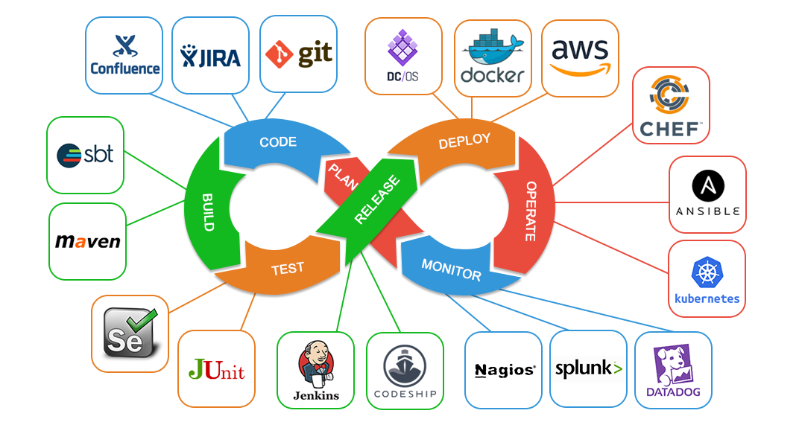
DevOps tools

Slide 3
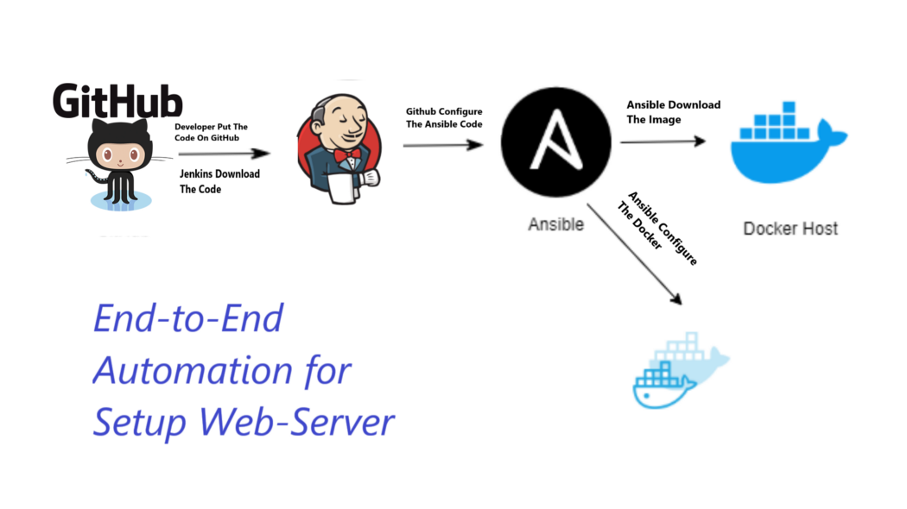
For our project we will use,

Slide 4
As developer put the code on GitHub.
Then DevOps person will start to,
Prepare our deployment environment as a K8s cluster on AWS using Terraform.
Implement the needed DevOps tools to create CI/CD pipeline using Ansible configuration management tool.
CI/CD Jenkins Pipeline using Groovy scripting Jenkins’ file.

Slide 5
Prepare our deployment environment as a K8s cluster on AWS using Terraform.
We’ll need to have the following resources installed to be able to follow along with the next steps:
o Terraform o kops o kubectl o AWS CLI
We need to create a couple of AWS resources, so let’s log in to the console and create “Amazon Simple Storage Service (Amazon S3) bucket” and “Amazon DynamoDB table”.
Then get the configuration files “backend.tf” & “config/test.tfvarsfor” terraform ready to setup our env.
backend.tf: contains the information about your Amazon S3 bucket and Amazon DynamoDB table.
config/test.tfvarsfor: contains the k8s cluster environment configuration.
Then initialize the Terraform and apply the terraform for the env. config. file.
Steps detailed: https://github.com/AlaaSHafeez/DevOps-Ass./edit/main/README.md

Slide 6
Implement the needed DevOps tools to create CI/CD pipeline using Ansible configuration management tool.
Installing Ansible.
Creating a "playbook.yaml" file.
Playbook.yaml: the file that contains Ansible roles that could automate the actors of our design, like a Sonar, Nexus and Jenkins server
Run the playbook.
Now our Jenkins, Nexus and Sonar tools are installed and ready.
Steps detailed: https://github.com/AlaaSHafeez/DevOps-Ass./edit/main/README.md

Slide 7
CI/CD Jenkins Pipeline using Groovy scripting Jenkins’ file.
Access the your Jenkins URL.
Create your jenkins pipline using groovy file to perform coming jobs,
Create a job chain of job1, job2, job3 and job4 using build pipeline plugin in Jenkins.
Job1 : Pull the Github repo automatically when some developers push repo to Github.
Job2 :
1. By looking at the code or program file, Jenkins should automatically start the respective language interpreter installed image container to deploy code on top of Kubernetes ( eg. If code is of PHP, then Jenkins should start the container that has PHP already installed )
2. Expose your pod so that testing team could perform the testing on the pod
3. Make the data to remain persistent using PVC ( If server collects some data like logs, other user information )

Slide 8
CI/CD Jenkins Pipeline using Groovy scripting Jenkins’ file.
Job3 : Test your app if it is working or not.
Job4 : if app is not working , then send email to developer with error messages and redeploy the application after code is being edited by the developer .
Build the job chain and see the magic!
Ref.: https://medium.com/@rplgurjar/ci-cd-pipeline-using-groovy-script-1b0b27a0e0cf

Slide 9
Thanks!

